Slide 1


CSCE 5640 Operating System Design Main Memory
Dr. Amar Maharjan
Computer Science and Engineering
University of North Texas
Slides (with some modifications) from:
Operating System Concepts 10 edition – Silberschatz, Galvin and Gagne © 2018
Notes:
All the programs should be loaded to the main memory to execute, and it becomes a process.
What if the program is very big or small, should all the content be loaded to memory or some part that is required?
How do we protect the data? Each process should access its own data only.

Slide 2
Outline
Background
Contiguous Memory Allocation
Paging
Structure of the Page Table
Swapping

Slide 3
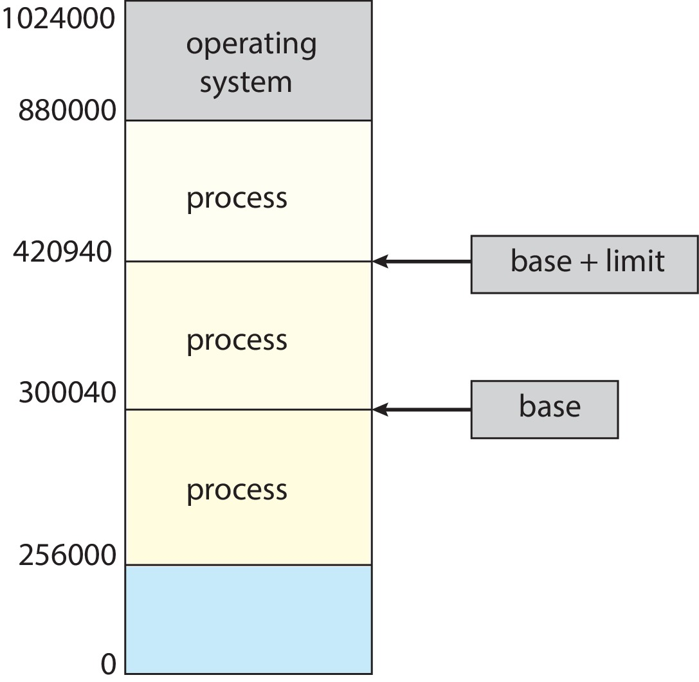
Protection
Need to ensure that a process can access only those addresses in its address space.
We can provide this protection by using a pair of base and limit registers define the logical address space of a process
Notes:
Each process has a base and limit register.
Assuming the entire program is loaded to memory, the program is not broken.
Any address between 300040 and 420940 is accessible only to that process.

Slide 4
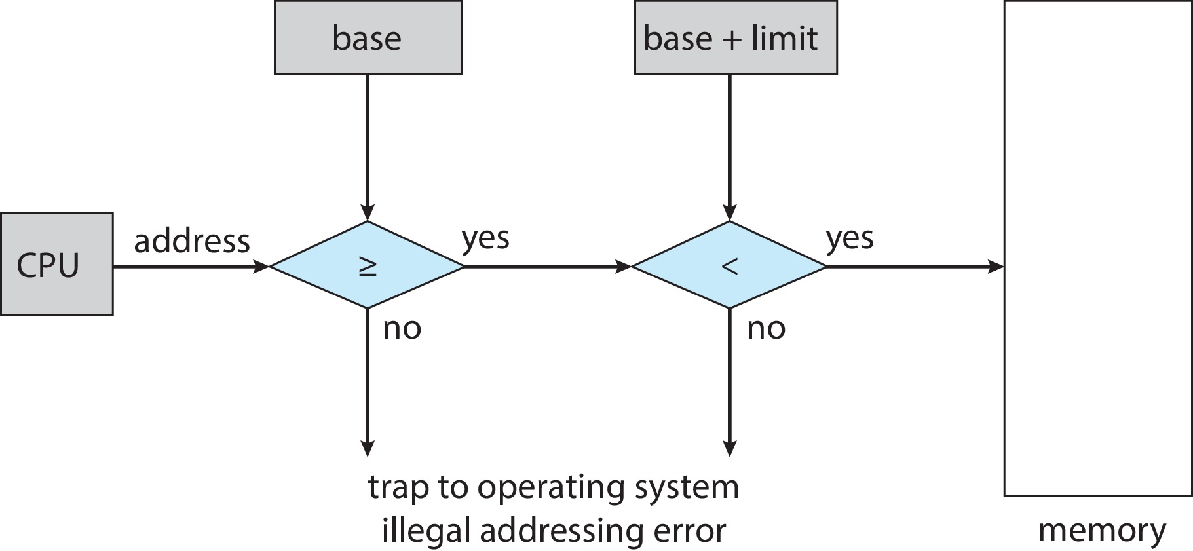
Hardware Address Protection
CPU must check every memory access generated in user mode to be sure it is between base and limit for that user
The instructions for loading the base and limit registers are privileged
Notes:
The address must be checked whether it is valid or not.
Trap: Interrupt or expectation will be generated to kill the process.
Updating the base and limit is only done by the kernel (OS), not by the user.

Slide 5
Address Binding
Programs on disk, ready to be brought into memory to execute form an input queue
Without support, must be loaded into address 0000
Inconvenient to have first user process physical address always at 0000
How can it not be?
Addresses represented in different ways at different stages of a program’s life
Source code addresses usually symbolic
Compiled code addresses bind to relocatable addresses
i.e., “14 bytes from beginning of this module”
Linker or loader will bind relocatable addresses to absolute addresses
i.e., 74014
Each binding maps one address space to another
Notes:
We are not concerned about which memory locates store the variables or functions.
This low-level stuff is handled by compilers or linkers and loaders.
If we write int x, We don’t know where the ‘x’ will be loaded because it can be compiled in any location.
Ex: If the program is loaded at 1000, then add 14 bytes and put the variables there. That is the absolute address.
It is updated in run time and the absolute address is loaded/updated/Binded.

Slide 6
Binding of Instructions and Data to Memory
Address binding of instructions and data to memory addresses can happen at three different stages
Compile time: If memory location known a priori, absolute code can be generated; must recompile code if starting location changes
Load time: Must generate relocatable code if memory location is not known at compile time
final binding is delayed until load time
Execution time: Binding delayed until run time if the process can be moved during its execution from one memory segment to another
Need hardware support for address maps (e.g., base and limit registers)
Notes:
The benefit of execution time is we can dynamically move the program information and data.
We will bind those variables/ information dynamically.

Slide 7
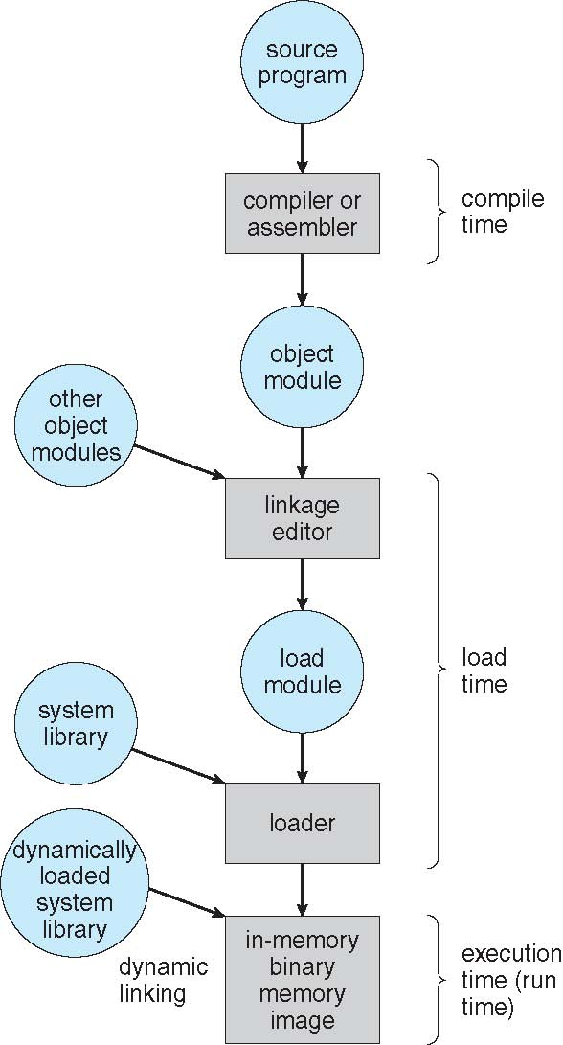
Multistep Processing of a User Program
Main focus of this chapter: showing how these various bindings can be implemented effectively in a computer system and to discussing appropriate hardware support.
Notes:
Object codes are relocatable.

Slide 8
Logical vs. Physical Address Space
The concept of a logical address space that is bound to a separate physical address space is central to proper memory management
Logical address – generated by the CPU; also referred to as virtual address
Physical address – address seen by the memory unit
Binding addresses at either compile or load time generates identical logical and physical addresses
In execution-time address-binding scheme, logical (virtual) and physical addresses differ
Logical address space is the set of all logical addresses generated by a program
Physical address space is the set of all physical addresses generated by a program
Notes:
Logical/Virtual address must be mapped to physical address space (Actual address).
Mapping is done by MMU (Memory management unit)
We have different techniques to map.

Slide 9
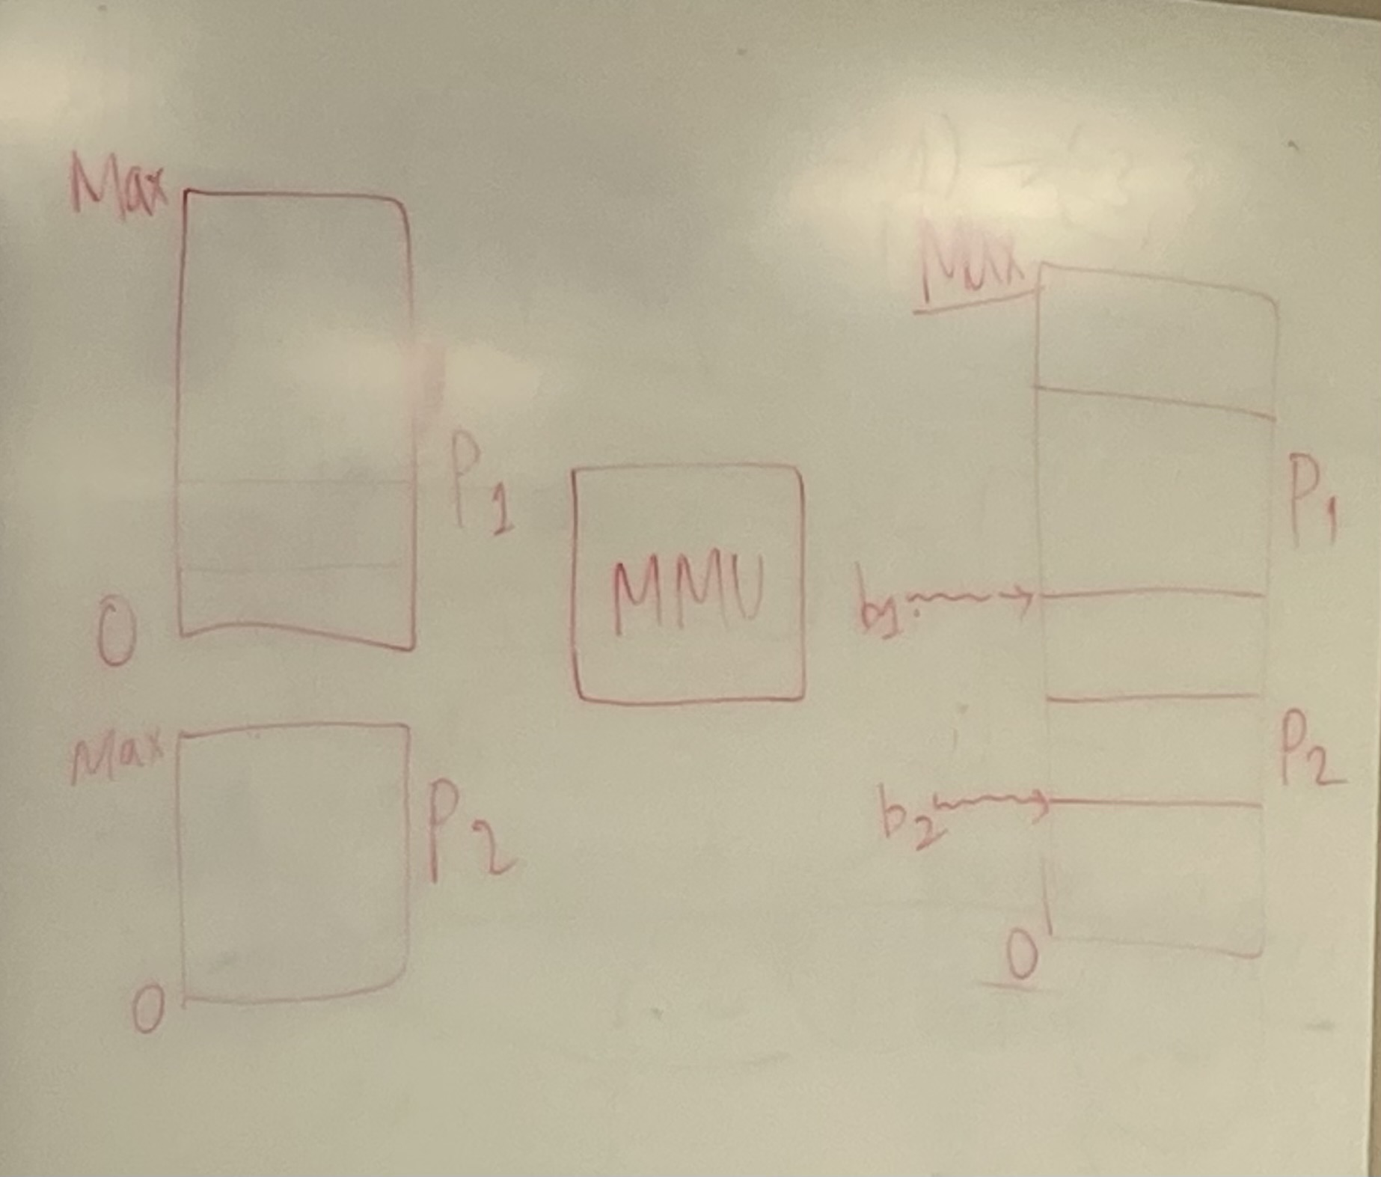
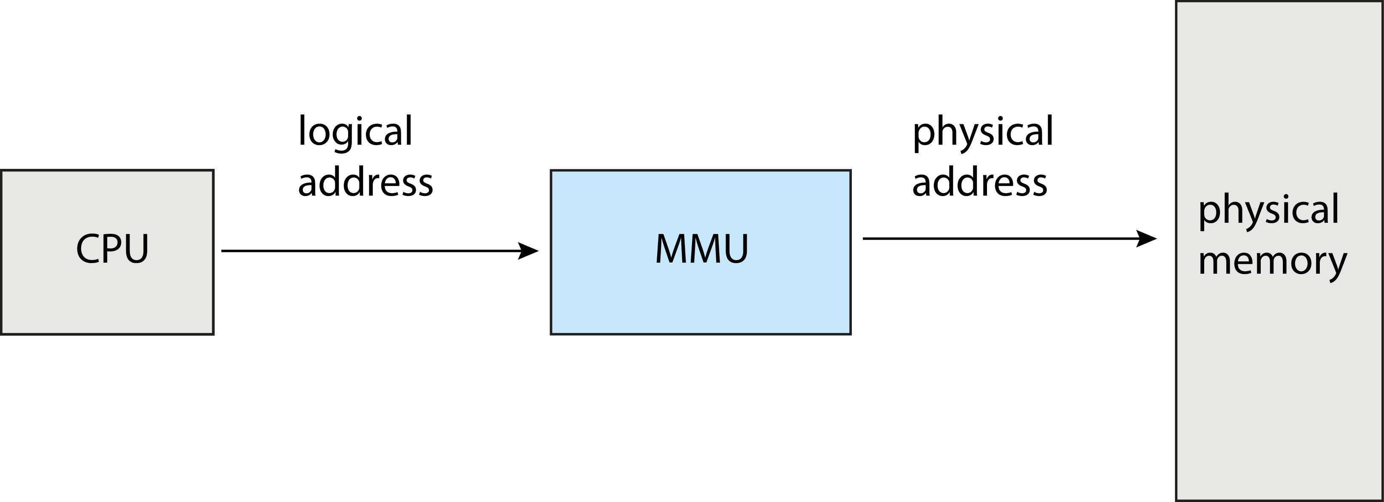
Memory-Management Unit (MMU)
Hardware device that at run time maps virtual to physical address
Many methods possible, covered in the rest of this chapter

Slide 10
Memory-Management Unit (contd.)
Consider simple scheme, which is a generalization of the base-register scheme.
The base register now called relocation register
The value in the relocation register is added to every address generated by a user process at the time it is sent to memory
The user program deals with logical addresses; it never sees the real physical addresses
Execution-time binding occurs when reference is made to location in memory
Logical address bound to physical addresses
Notes:
For the process, the OS will maintain the base register/relocation register.

Slide 11
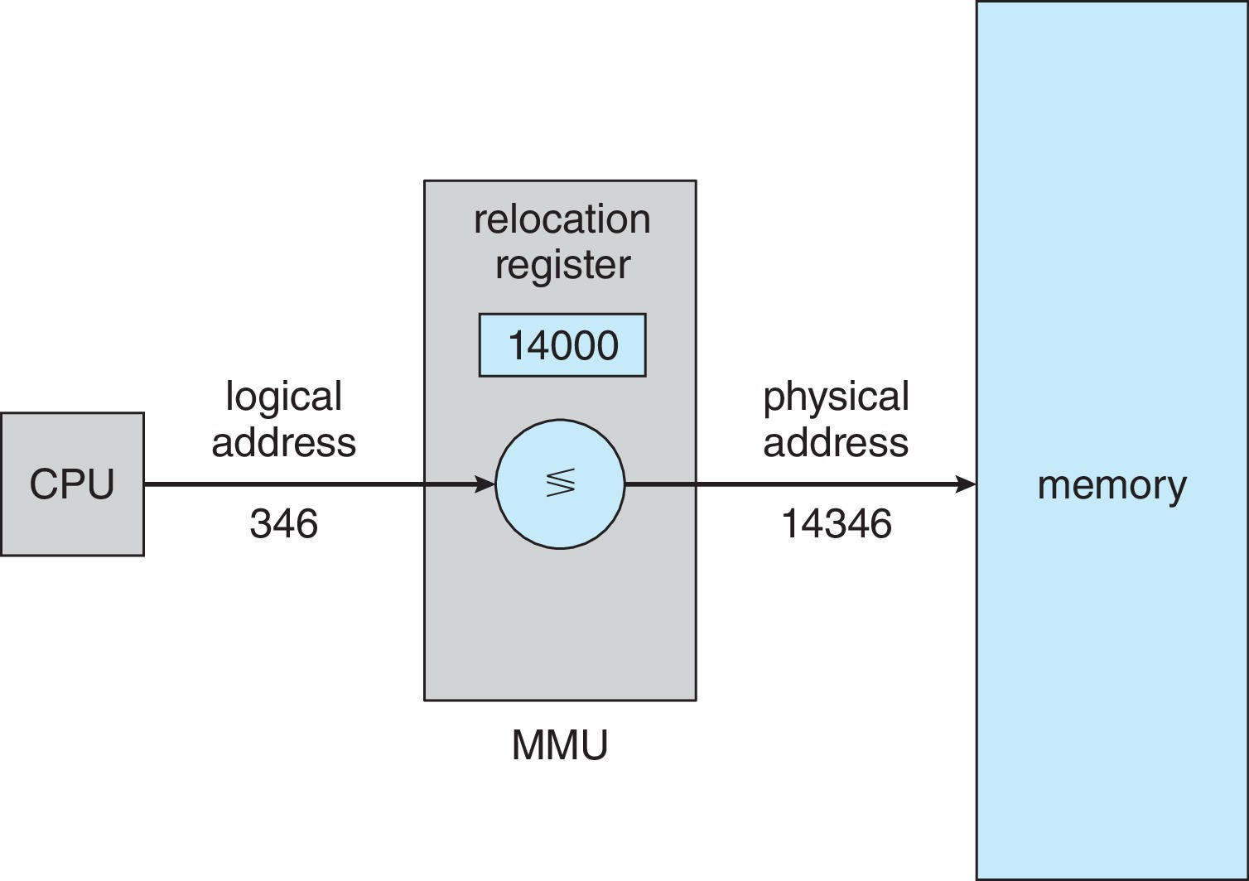
Memory-Management Unit (contd.)
Notes:
14000 is the base address maintained by the OS.
If we are trying to access the location of 346.

Slide 12
Dynamic Loading
The entire program does need to be in memory to execute
Routine is not loaded until it is called
Better memory-space utilization; unused routine is never loaded
All routines kept on disk in relocatable load format
Useful when large amounts of code are needed to handle infrequently occurring cases
No special support from the operating system is required
Implemented through program design
OS can help by providing libraries to implement dynamic loading
Notes:
When a routine needs to call another routine, the calling routine first checks to see whether the other routine has been loaded.
If it has not, the relocatable linking loader is called to load the desired routine into memory and to update the program’s address tables to reflect this change.
Then control is passed to the newly loaded routine.
This allows us to load modules/libraries/functions/routines only when it is called. If it's not called, then we don’t load those.

Slide 13
Dynamic Linking
Static linking – system libraries and program code combined by the loader into the binary program image
Dynamic linking – linking postponed until execution time
Operating system checks if routine is in processes’ memory address
If not in address space, add to address space
Dynamic linking is particularly useful for libraries
System also known as shared libraries
DLLs can be extended to library updates (such as bug fixes)
Notes:
Stub: A small, temporary place-holder function replaced by the full function once its expected behavior is known.
A small piece of code, stub, used to locate the appropriate memory-resident library routine
Stub replaces itself with the address of the routine, and executes the routine
The benefit of static linking is we don’t need to load dynamically.
It runs fast.
The cons is that we will occupy lot of space in the memory.
Shared libraries (Windows OS call this as DLL – Dynamically Link Libraries) will be shared by all the programs.

Slide 14
Contiguous Allocation
Main memory must support both OS and user processes
Limited resource, must allocate efficiently
Contiguous allocation is one early method
Main memory usually divided into two partitions:
Resident operating system, usually held in low memory with interrupt vector
User processes then held in high memory
Each process contained in single contiguous section of memory
Notes:
Contiguous: One after another, without any gap.
It has lots of limitations, which will be solved using paging.
OS can be loaded in the lower section or upper section. As per the author, in Linux, it is loaded in the upper section.
All other spaces can be used to load the programs.
Two partitions: OS and non-OS processes.

Slide 15
Contiguous Allocation – Memory Protection
Relocation registers used to protect user processes from each other, and from changing operating-system code and data
Base register contains value of smallest physical address
Limit register contains range of logical addresses – each logical address must be less than the limit register
MMU maps logical address dynamically
Notes:
Can then allow actions such as kernel code being transient and kernel changing size

Slide 16
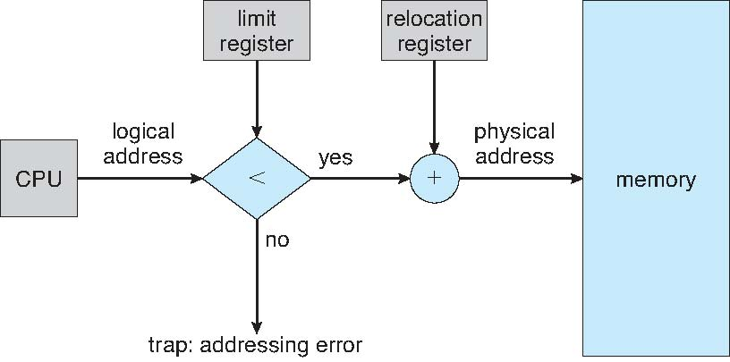
Hardware Support for Relocation and Limit Registers
Notes:
This works because the programs are loaded in contiguous in the main memory.

Slide 17
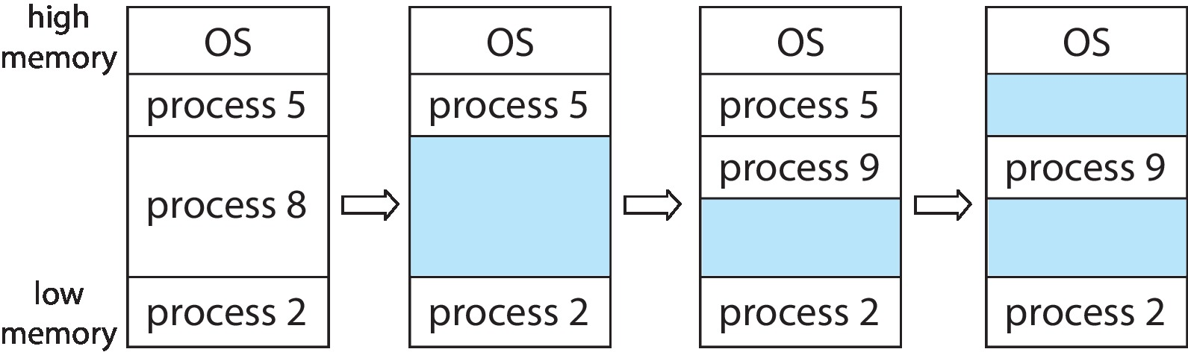
Variable Partition
Multiple-partition allocation
Degree of multiprogramming limited by number of partitions
Variable-partition sizes for efficiency (sized to a given process’ needs)
Hole – block of available memory; holes of various size are scattered throughout memory
When a process arrives, it is allocated memory from a hole large enough to accommodate it
Process exiting frees its partition, adjacent free partitions combined
Operating system maintains information about: a) allocated partitions b) free partitions (hole)
Notes:
Process 8 is done executing.
An unused part is called a “Hole”.
Should we load the new process at the top or bottom? It depends.
In the last step, we have non-contiguous, so that is a problem.
Let's put the new process, where it generates a small hole or maximum hole. It depends on situation.

Slide 18
Dynamic Storage-Allocation Problem
How to satisfy a request of size n from a list of free holes?
First-fit: Allocate the first hole that is big enough
Best-fit: Allocate the smallest hole that is big enough; must search entire list, unless ordered by size
Produces the smallest leftover hole
Worst-fit: Allocate the largest hole; must also search entire list
Produces the largest leftover hole
First-fit and best-fit are better than worst-fit in terms of speed and storage utilization
Notes:
Best fit, Worst fit: O(n), check all the holes, this is the drawback.

Slide 19
Fragmentation
External Fragmentation – total memory space exists to satisfy a request, but it is not contiguous
Another factor is which end of a free block is allocated. (Which is the leftover piece—the one on the top or the one on the bottom?)
Internal Fragmentation
Approach: break the physical memory into fixed-sized blocks and allocate memory in units based on block size.
allocated memory may be slightly larger than requested memory; this size difference is memory internal to a partition, but not being used
Statistical first fit analysis reveals that given N blocks allocated, another 0.5 N blocks will be lost to fragmentation
1/3 may be unusable -> 50-percent rule
Notes:
Internal Fragmentation:
Assume we will divide the memory into fixed-size blocks. Ex: 4KB.
If my program is 8KB, we can load the program in 2 blocks. If the size is 10KB, we need three blocks. The unused block (2KB) is internal fragmentation.
If we have N blocks, 50% of those N blocks will be lost due to fragmentation (Internal and External).

Slide 20
Fragmentation (Cont.)
Reduce external fragmentation by compaction
Shuffle memory contents to place all free memory together in one large block
Compaction is possible only if relocation is dynamic, and is done at execution time
Another possible solution to the external-fragmentation problem
permit the logical address space of processes to be noncontiguous,
thus, allowing a process to be allocated physical memory wherever such memory is available
Paging
Notes:
Compaction: Move all holes in one direction by moving the process.
Another possible solution is using pain techniques. Load the programs in small portions and load those portions in the holes.

Slide 21
Paging
Physical address space of a process can be noncontiguous; process is allocated physical memory whenever the latter is available
Avoids external fragmentation
Avoids problem of varying sized memory chunks
Divide physical memory into fixed-sized blocks called frames
Size is power of 2, between 512 bytes and 16 Mbytes
Divide logical memory into blocks of same size called pages
Keep track of all free frames
To run a program of size N pages, need to find N free frames and load program
Set up a page table to translate logical to physical addresses
Still have Internal fragmentation
Notes:
Dividing processes into blocks of memory or processes called pages.
Typically, frame size is a power of 2, so that calculation is easy.
Process is divided into → Pages → Stored in different frames.
OS keeps track of which frames are occupied and which frames are free.
Map page number to frame number → Page table

Slide 22
Address Translation Scheme
Address generated by CPU is divided into:
Page number (p) – used as an index into a page table which contains base address of each page in physical memory
Page offset (d) – combined with base address to define the physical memory address that is sent to the memory unit
For given logical address space 2^{m} and page size 2^{n}

Slide 23
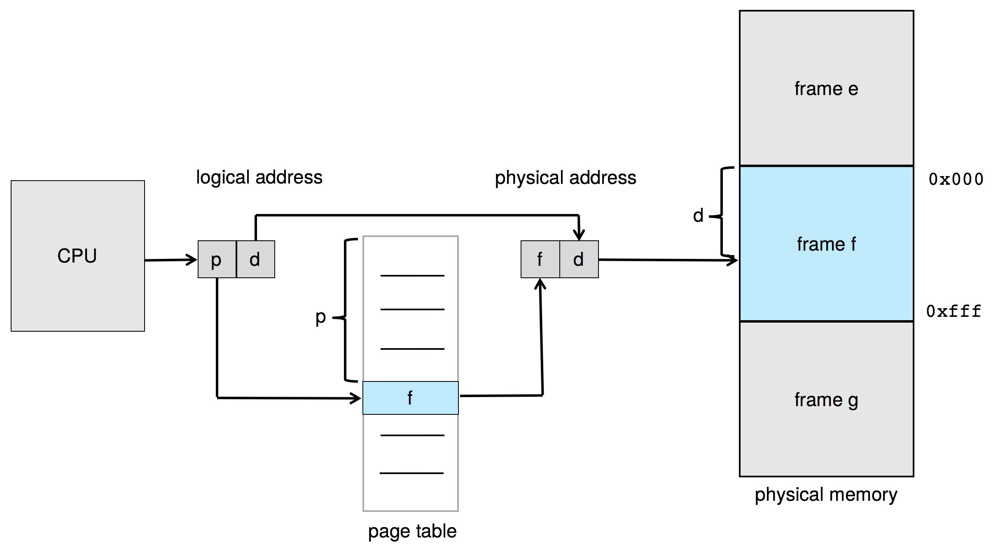
Paging Hardware
Notes:
Assume the page table is a one-dimensional array, then the logical address (p) is the index, and the physical address (f) is the value at index ‘p.’

Slide 24
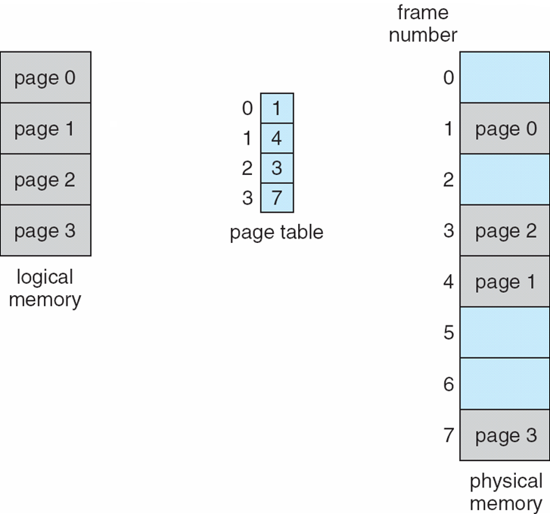
Paging Model of Logical and Physical Memory
Notes:
Inside the page, the data could be present anywhere. Where the data is present is denoted by the offset.

Slide 25
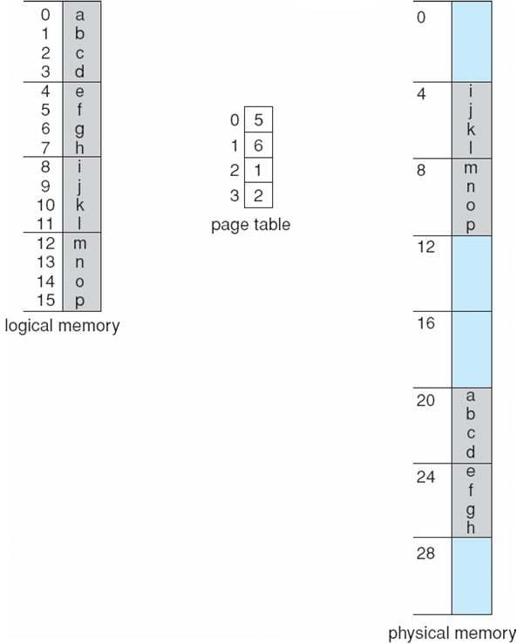
Paging Example
Logical address: n = 2 and m = 4.
Using a page size of 4 bytes and a physical memory of 32 bytes
Notes:
Process = 2^m / 2^n = 2^4/2^2 = 4
Divide logical memory into four parts. (16/4 = 4 → Each is 4bytes)
Ex: If I am interested in 14 – o.
14: 1110
M-n = 2
1st 2 bits: 11 → p, 10 → d
11 = 3 → Page 3
Offset → 10 = 2
Skip 2
We use 4 bits because we can represent 16 combination using 4 bits. Log2(16)=4.

Slide 26
Paging -- Calculating internal fragmentation
Page size = 2,048 bytes (2¹¹)
Process size = 72,766 bytes
35 pages + 1,086 bytes
Internal fragmentation of 2,048 - 1,086 = 962 bytes
Worst case fragmentation = 1 frame – 1 byte
On average fragmentation = 1 / 2 frame size
So small frame sizes desirable?
But each page table entry takes memory to track
Notes:
2048 byte = 2 kilobytes.
962 bytes will be unused.
In the worst case, sometimes we need one extra page to store just 1-byte → Remaining page is wasted.
Bigger the page size, bigger the internal fragmentation.
But if we have small pages we will have more entries in the page table, so we need to balance and find the perfect page size.

Slide 27
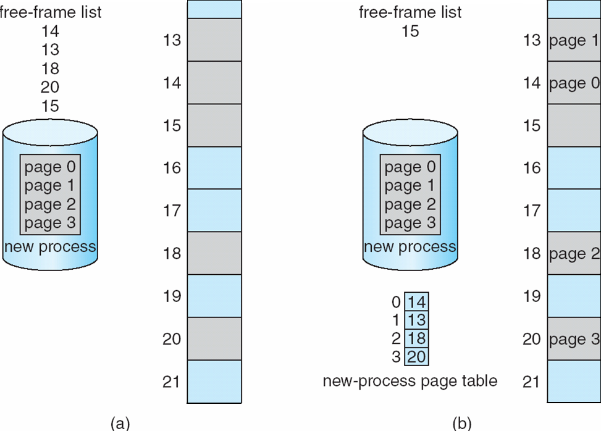
Free Frames
Before allocation
After allocation
Notes:
Gray: Free frames
Blue: Occupied.
Each process has a separate page table.

Slide 28
Implementation of Page Table
Page table is kept in main memory
Page-table base register (PTBR) points to the page table
Page-table length register (PTLR) indicates size of the page table
In this scheme every data/instruction access requires two memory accesses
One for the page table and one for the data/instruction
The two-memory access problem can be solved by the use of a special fast-lookup hardware cache called translation look-aside buffers (TLBs) (also called associative memory).
Notes:
We can store the register values in PCB(Process Control Block). Whenever the process is switched, the registers are also changed.
TLB → Hardware implemented a buffer.
TLB is very fast because the search is done is parallel.
The disadvantage is it contains small buffers. So we need to store entries in TLB smartly.

Slide 29
Hardware
Associative memory – parallel search
Address translation (p, d)
If p is in associative register, get frame # out
Otherwise get frame # from page table in memory
Notes:
Page number or frame number mapping.

Slide 30
Translation Look-Aside Buffer
Some TLBs store address-space identifiers (ASIDs) in each TLB entry – uniquely identifies each process to provide address-space protection for that process
Otherwise need to flush at every context switch
TLBs typically small (64 to 1,024 entries)
On a TLB miss, value is loaded into the TLB for faster access next time
Replacement policies must be considered
Some entries can be wired down for permanent fast access
Notes:
Apart from the page number and frame number, we need extra information (ASIDs).
We will add the process ID also because multiple processes can have page 0.

Slide 31
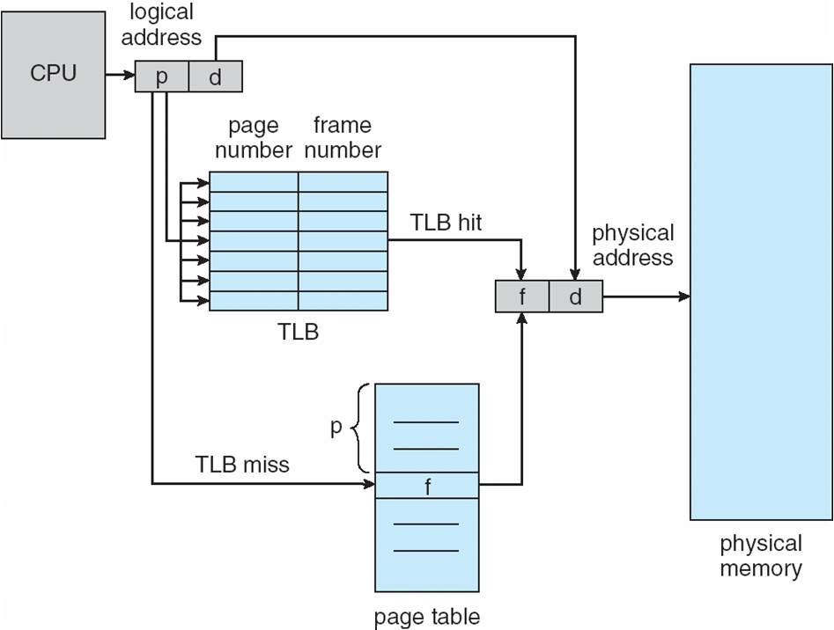
Paging Hardware With TLB
Notes:
1st, we search in TLB, if we don’t find it, then we go with the traditional method, which is searching in the page table.

Slide 32
Effective Access Time
Hit ratio – percentage of times that a page number is found in the TLB
An 80% hit ratio means that we find the desired page number in the TLB 80% of the time.
Suppose that 10 nanoseconds to access memory.
If we find the desired page in TLB then a mapped-memory access take 10 ns
Otherwise, we need two memory access, so it is 20 ns
Effective Access Time (EAT)
EAT = 0.80 x 10 + 0.20 x 20 = 12 nanoseconds
implying 20% slowdown in access time
Consider a more realistic hit ratio of 99%,
EAT = 0.99 x 10 + 0.01 x 20 = 10.1ns
implying only 1% slowdown in access time.
Notes:
If: Access data = 10ns
Otherwise: Hit page table + Access data = 10ns + 10ns
We need to try to hit the TLB as much as possible.
If we improve the hit ration we can improve the performance.

Slide 33
Memory Protection
Memory protection implemented by associating protection bit with each frame to indicate if read-only or read-write access is allowed
Can also add more bits to indicate page execute-only, and so on
Valid-invalid bit attached to each entry in the page table:
“valid” indicates that the associated page is in the process’ logical address space, and is thus a legal page
“invalid” indicates that the page is not in the process’ logical address space
Or use page-table length register (PTLR)
Any violations result in a trap to the kernel

Slide 34
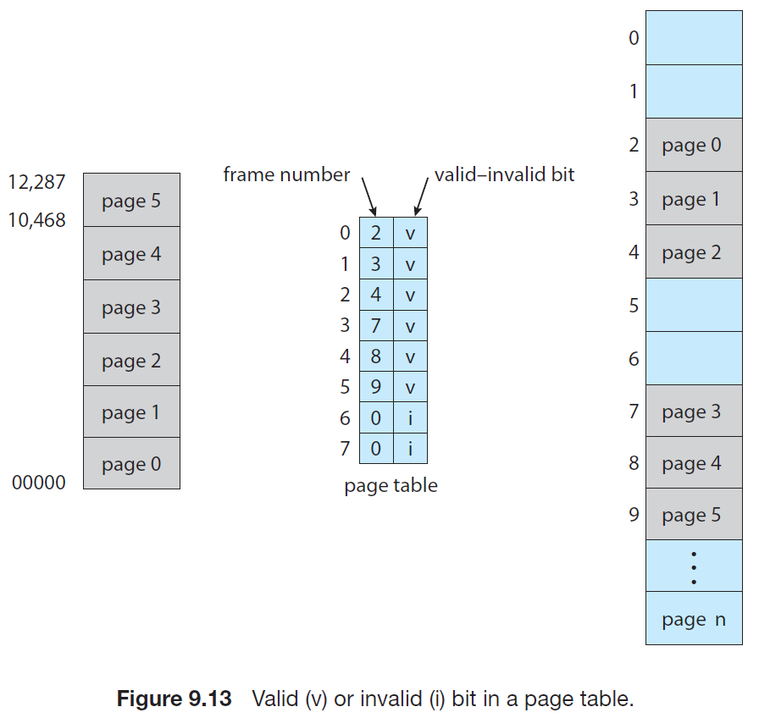
Valid (v) or Invalid (i) Bit In A Page Table
Suppose, for example, that in a system with a 14-bit address space (0 to 16383)
We have a program that should use only addresses 0 to 10468.
Given a page size of 2KB
Notes:
Number of pages: 2^14 / 2^11 = 2^3 = 8 [11 because 2KB = 2048 bytes = 2^11]
Number of pages required: 10468/2048 = 5.11 = 6 pages [2048bytes=2KB]
’v’ means valid
‘I’ means invalid
Anything linked to pages 6 and 7 is invalid.
Kernal will handle invalid access.

Slide 35
Shared Pages
Shared code
One copy of read-only (reentrant) code shared among processes (i.e., text editors, compilers, window systems)
Similar to multiple threads sharing the same process space
Also useful for interprocess communication if sharing of read-write pages is allowed
Private code and data
Each process keeps a separate copy of the code and data
The pages for the private code and data can appear anywhere in the logical address space
Notes:
There can be some pages that can be common.
Ex: Compiling C program implements standard C library. We can link each program to the library, which takes a lot of memory. We can divide the library into multiple frames, and all programs can utilize them.

Slide 36
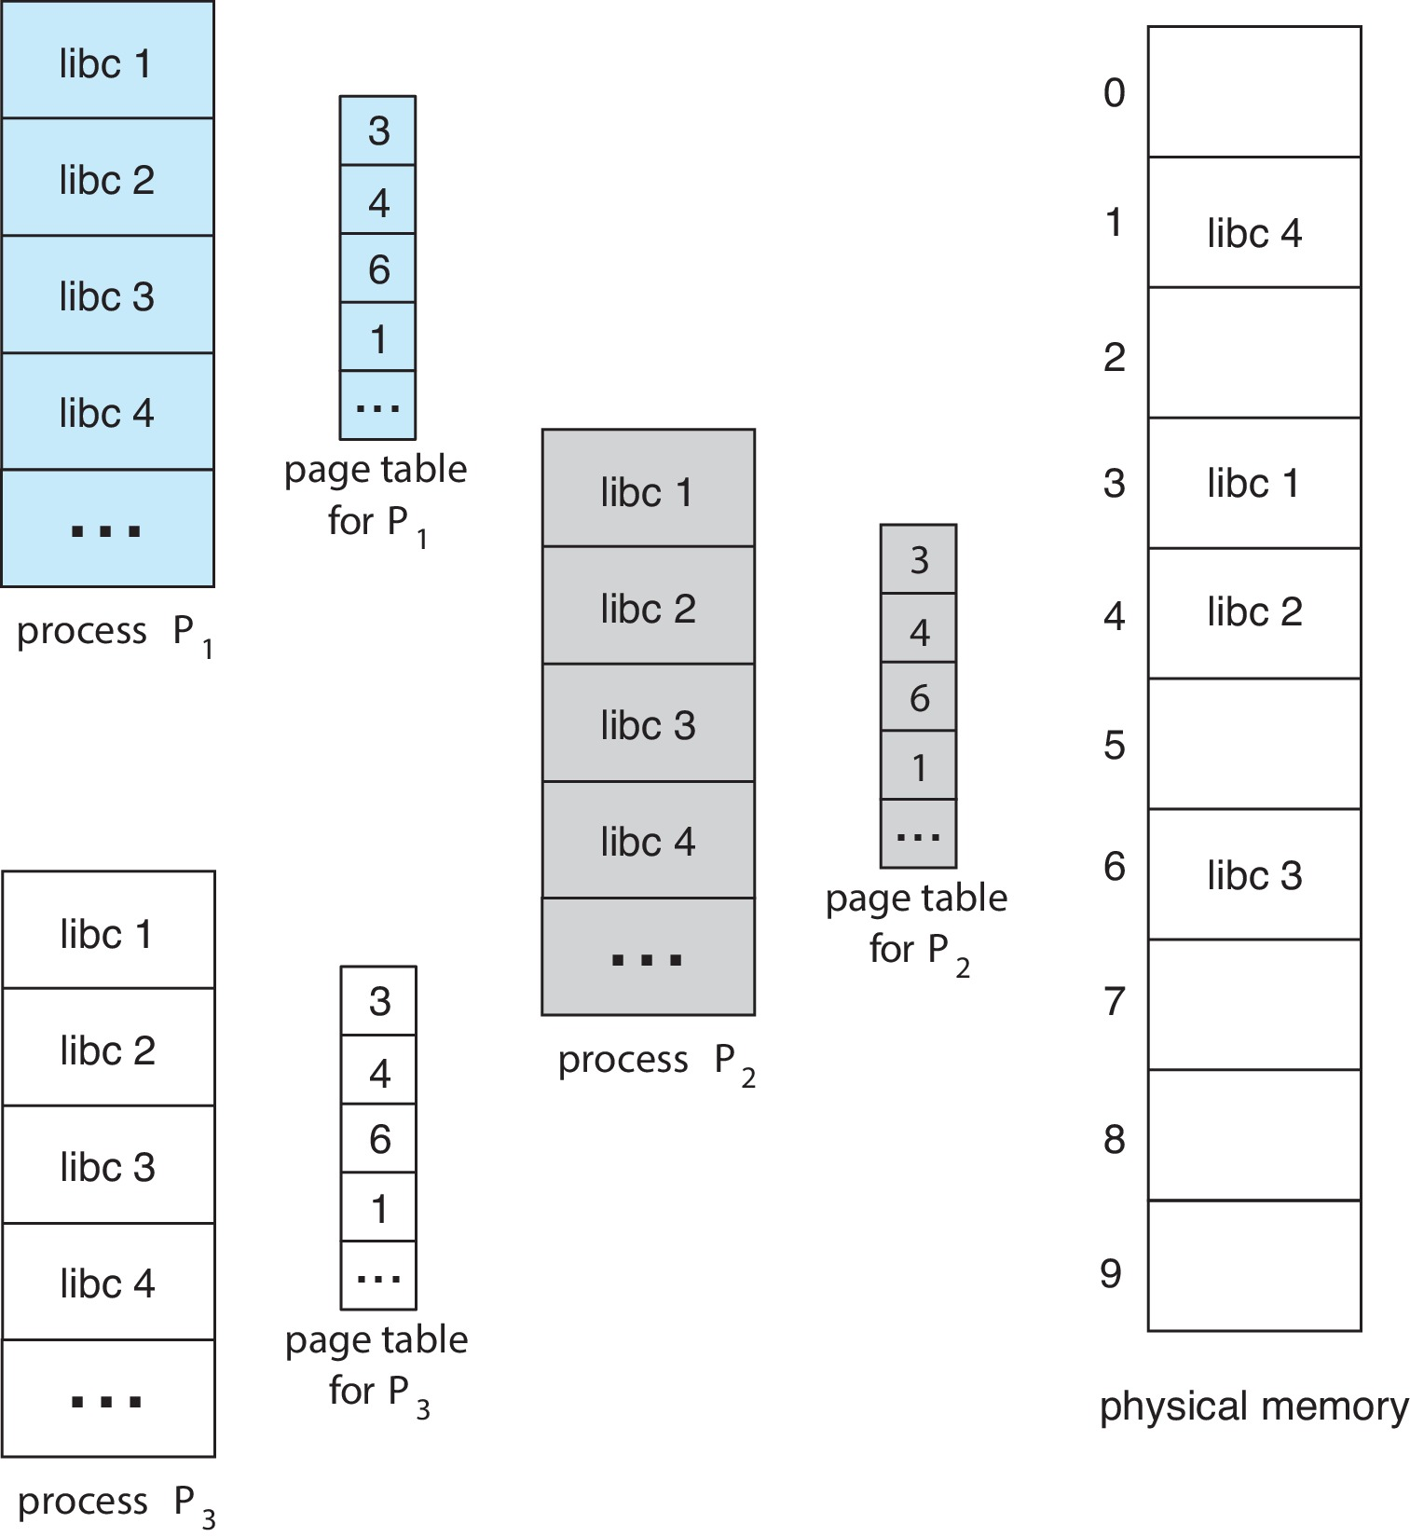
Shared Pages Example

Slide 37
Structure of the Page Table
Memory structures for paging can get huge using straight-forward methods
Consider a 32-bit logical address space as on modern computers
Page size of 4 KB (2¹²)
Page table would have 1 million entries (2²⁰ ⁼ 2³² / 2¹²)
If each entry is 4 bytes ➔ each process 4 MB of physical address space for the page table alone
Don’t want to allocate that contiguously in main memory
One simple solution is to divide the page table into smaller units
Hierarchical Paging
Hashed Page Tables
Inverted Page Tables

Slide 38
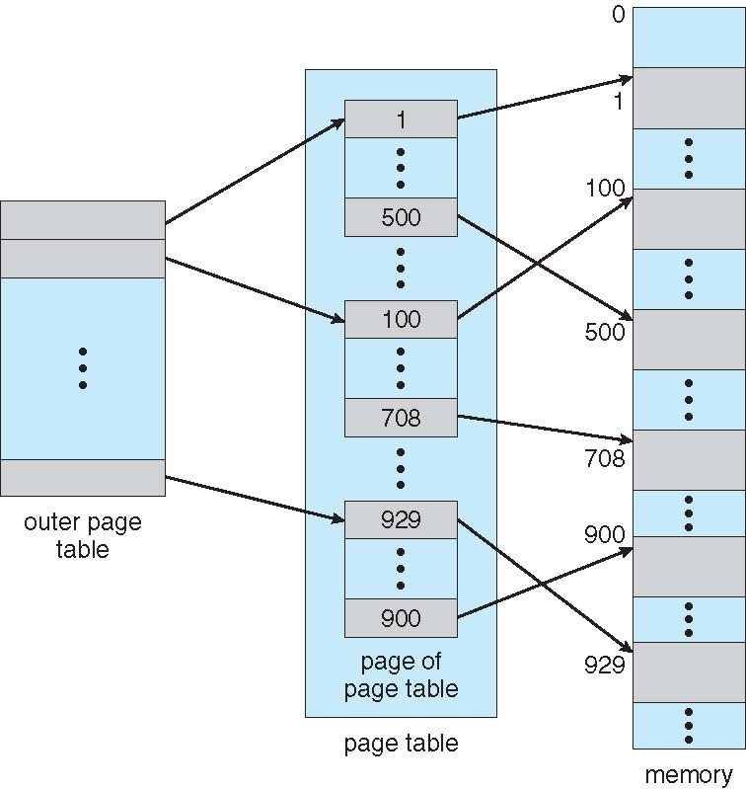
Hierarchical Page Tables
Break up the logical address space into multiple page tables
A simple technique is a two-level page table
We then page the page table
Notes:
The idea is to use the page table of the page table.

Slide 39
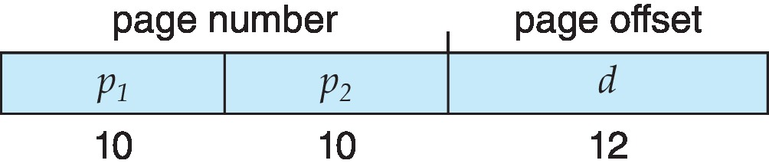
Two-Level Paging Example
A logical address (on 32-bit machine with 4K page size) is divided into:
a page number consisting of 20 bits
a page offset consisting of 12 bits
Since the page table is paged, the page number is further divided into:
a 10-bit page number
a 10-bit page offset
Thus, a logical address is as follows:
where p₁ is an index into the outer page table, and p₂ is the displacement within the page of the inner page table
Known as forward-mapped page table

Slide 40
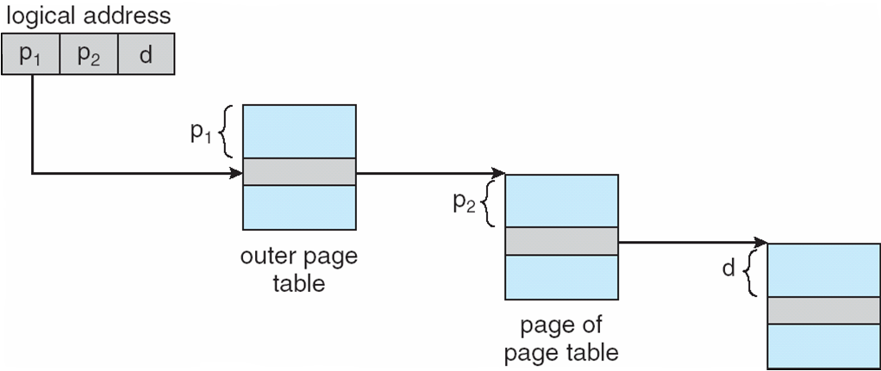
Address-Translation Scheme

Slide 41
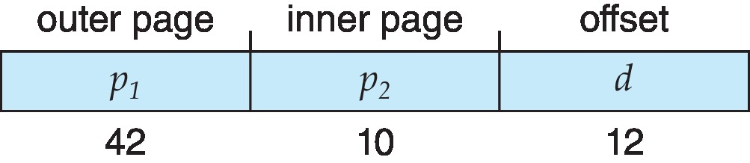
64-bit Logical Address Space
Even two-level paging scheme not sufficient
If page size is 4 KB (2¹²)
Then page table has 2⁵² entries
If two level scheme, inner page tables could be 2¹⁰ 4-byte entries
Address would look like
Outer page table has 2⁴² entries or 2⁴⁴ bytes
One solution is to add a 2nd outer page table
But in the following example the 2nd outer page table is still 2³⁴ bytes in size
And possibly 4 memory access to get to one physical memory location

Slide 42
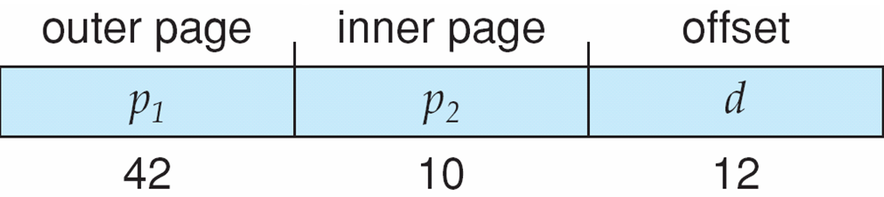
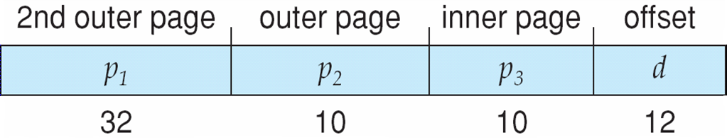
Three-level Paging Scheme
Notes:
It can introduce more compilations.
It's not good for reality.

Slide 43
Hashed Page Tables
Common in address spaces > 32 bits
The virtual page number is hashed into a page table
This page table contains a chain of elements hashing to the same location
Each element contains (1) the virtual page number (2) the value of the mapped page frame (3) a pointer to the next element
Virtual page numbers are compared in this chain searching for a match
If a match is found, the corresponding physical frame is extracted
Notes:
Each linked list node has three things (Bullet point 3)

Slide 44
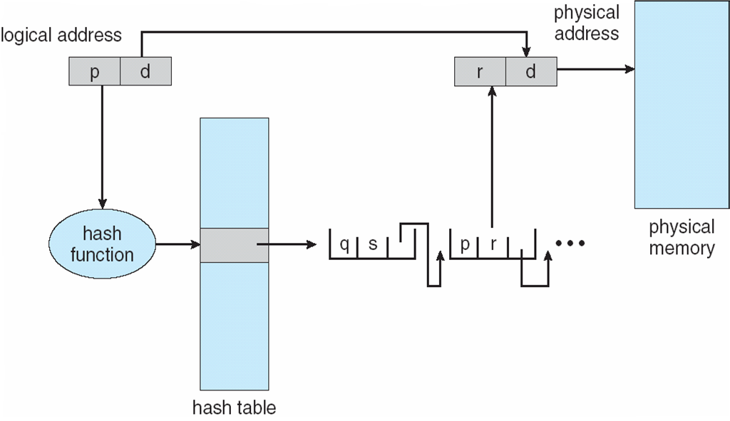
Hashed Page Table
Notes:
p matches p (1st value) so return r (2nd value).

Slide 45
Inverted Page Table
Rather than each process having a page table and keeping track of all possible logical pages, track all physical pages
One entry for each real page of memory
Entry consists of the virtual address of the page stored in that real memory location, with information about the process that owns that page
Decreases memory needed to store each page table, but increases time needed to search the table when a page reference occurs
Use hash table to limit the search to one — or at most a few — page-table entries
TLB can accelerate access
But how to implement shared memory?
One mapping of a virtual address to the shared physical address
Notes:
There is only one inverted page table, which is used by all processes.
If we have 1000 frames in the main memory, then we will have 1000 entries in the table.

Slide 46
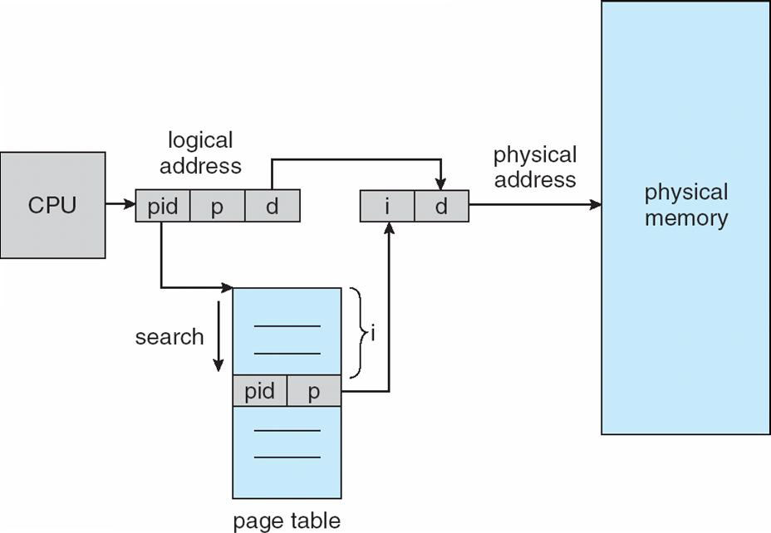
Inverted Page Table Architecture
Notes:
Search from top to bottom until it matches pid and p.
Now index 0,1,2,3 are actually frames., which contain the page numbers.
Mapping is from frame number to page number.

Slide 47
Swapping
A process can be swapped temporarily out of memory to a backing store, and then brought back into memory for continued execution
Total physical memory space of processes can exceed physical memory
Backing store – fast disk large enough to accommodate copies of all memory images for all users; must provide direct access to these memory images
Roll out, roll in – swapping variant used for priority-based scheduling algorithms; lower-priority process is swapped out so higher-priority process can be loaded and executed
Major part of swap time is transfer time; total transfer time is directly proportional to the amount of memory swapped
Notes:
A backing store is nothing but a backup (Hard-disk)
Why do we need to kick out from memory? → because we need space.
OS is responsible for deciding which process should be swapped.
Main issues: It takes lot of time.
We can swap a certain number of pages and bring only certain pages that are required.

Slide 48
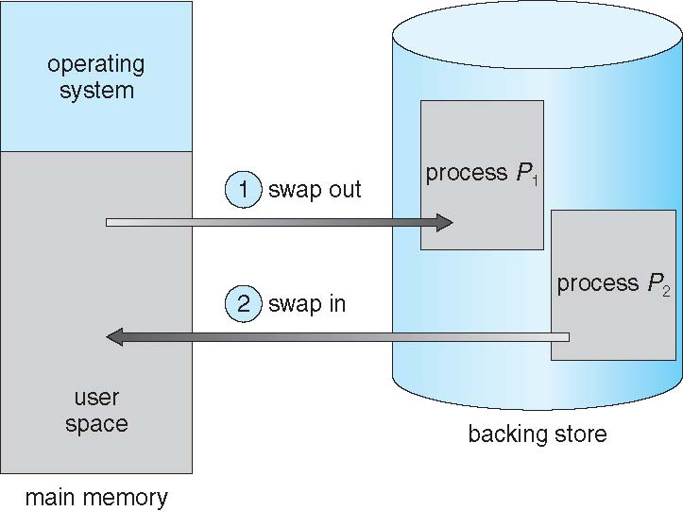
Schematic View of Swapping

Slide 49
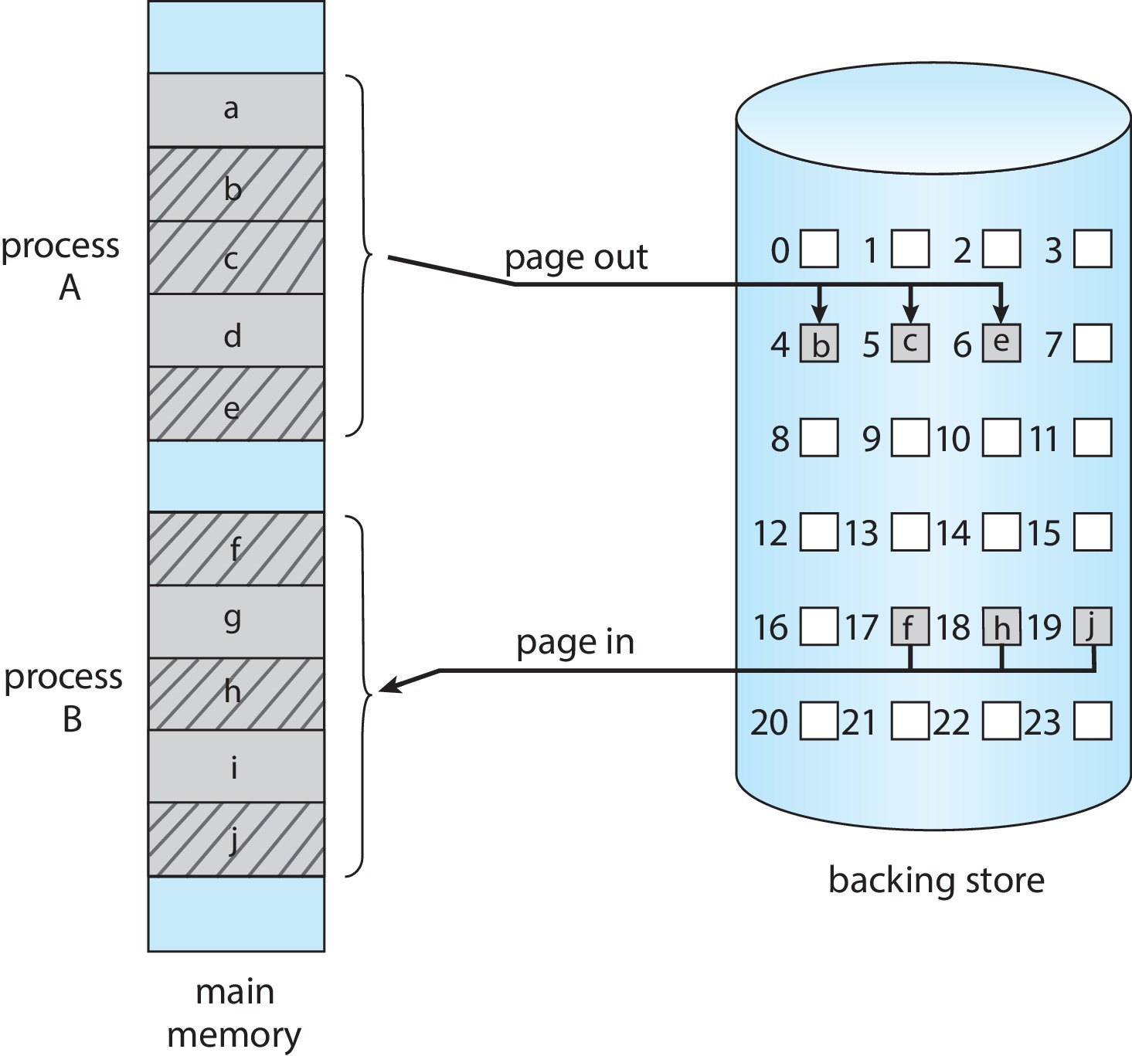
Swapping with Paging
Standard swapping not used in modern operating systems
Because the amount of time required to move entire processes between memory and the backing store is prohibitive.
Most systems, including Linux and Windows, now use a variation of swapping in which pages of a process—rather than an entire process—can be swapped.
Notes:
Swap in and out a certain number of pages.

Slide 50
Swapping on Mobile Systems
Not typically supported
Flash memory based
Small amount of space
Limited number of write cycles
Poor throughput between flash memory and CPU on mobile platform
Instead use other methods to free memory if low
iOS asks apps to voluntarily relinquish allocated memory
Read-only data thrown out and reloaded from flash if needed
Failure to free can result in termination
Android terminates apps if low free memory, but first writes application state to flash for fast restart
Notes:
Not supported → Because there is no hard disk drive. We don’t have enough space on a mobile, and it also takes a lot of time on the phone.

